Slide 1
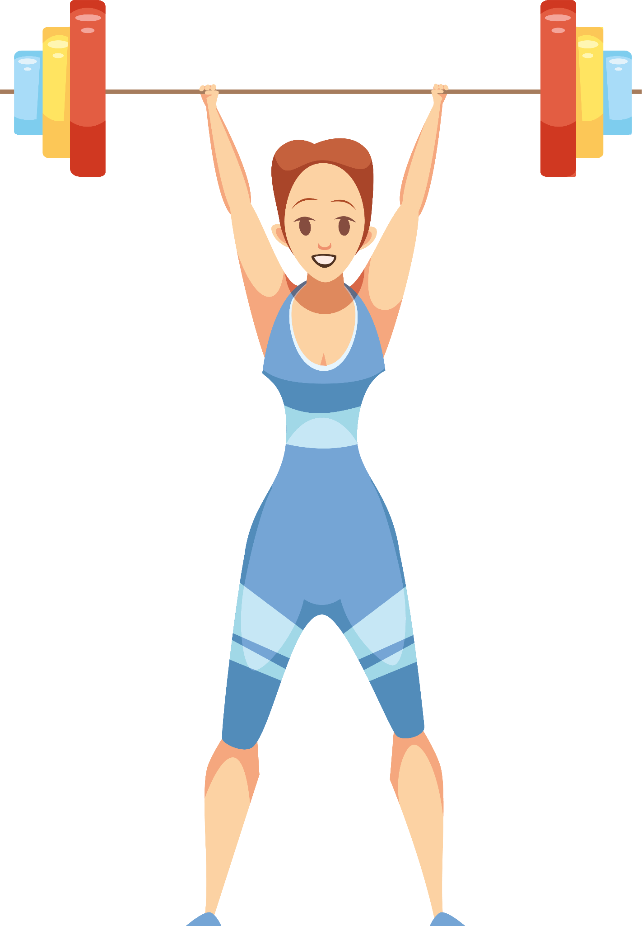
Destigmatize Nutrition:
Nutrition guide for teen girls
Trigger warning: eating disorders, body image issues, and extreme dieting
If at any point it feels too overwhelming, do whatever you need to feel safe
Our definition of girl: non-guy
(includes non-binary folx)

Slide 2
Check-in question:
Would you rather be invisible or have the ability to fly for a day?

Slide 3
Check-in question:
How many hours of sleep did you get last night?

Slide 4
Check-in question:
Does pineapple belong on pizza? Yes or no?

Slide 5
Check-in question:
Would you rather be a foot or ten feet tall?

Slide 6
Welcome
everyone
I’m Julia, sophomore, runner + cycler
I’m Jazmin, junior, soccer player
I’m Aasha, sophomore, climber
Change your name to “FirstName (Pronouns)

Slide 7
Agenda for today
TIME | Activity
3:05 - 3:15 | Conversation 1
3:15- 3:40 | Presentation About Nutrition + Doctor Speaker
3:40 - 3:50 | Athlete Speaker
3:50 - 3:55 | Conversation 2
3:55 - 4:00 | Closing

Slide 8
Guidelines/norms for discussion
Share as much as you feel comfortable sharing
What’s said in the zoom, stays in the zoom
Listen respectfully and attentively
When asking questions come from a place of curiosity not argumentation
Respect silence as part of the process
Take space, make space, and invite in
Speak from the “I” perspective

Slide 9
Convo 1
What?
3-4 girls per room + one moderator
It’s ok if it’s awkward
Prompts (moderators will put in chat)
Short intros: Name, grade, tell us about your sport.
Define healthy eating, what does it mean to you?
Do you feel like you understand nutrition? Who is in charge of what you eat?
What have people told you in the past about nutrition, what you should eat or not? Do you think they were right?
What do you wish people knew about nutrition as a teen girl? Do you think teen girls have unique nutritional needs compared to other ages/genders?

Slide 10
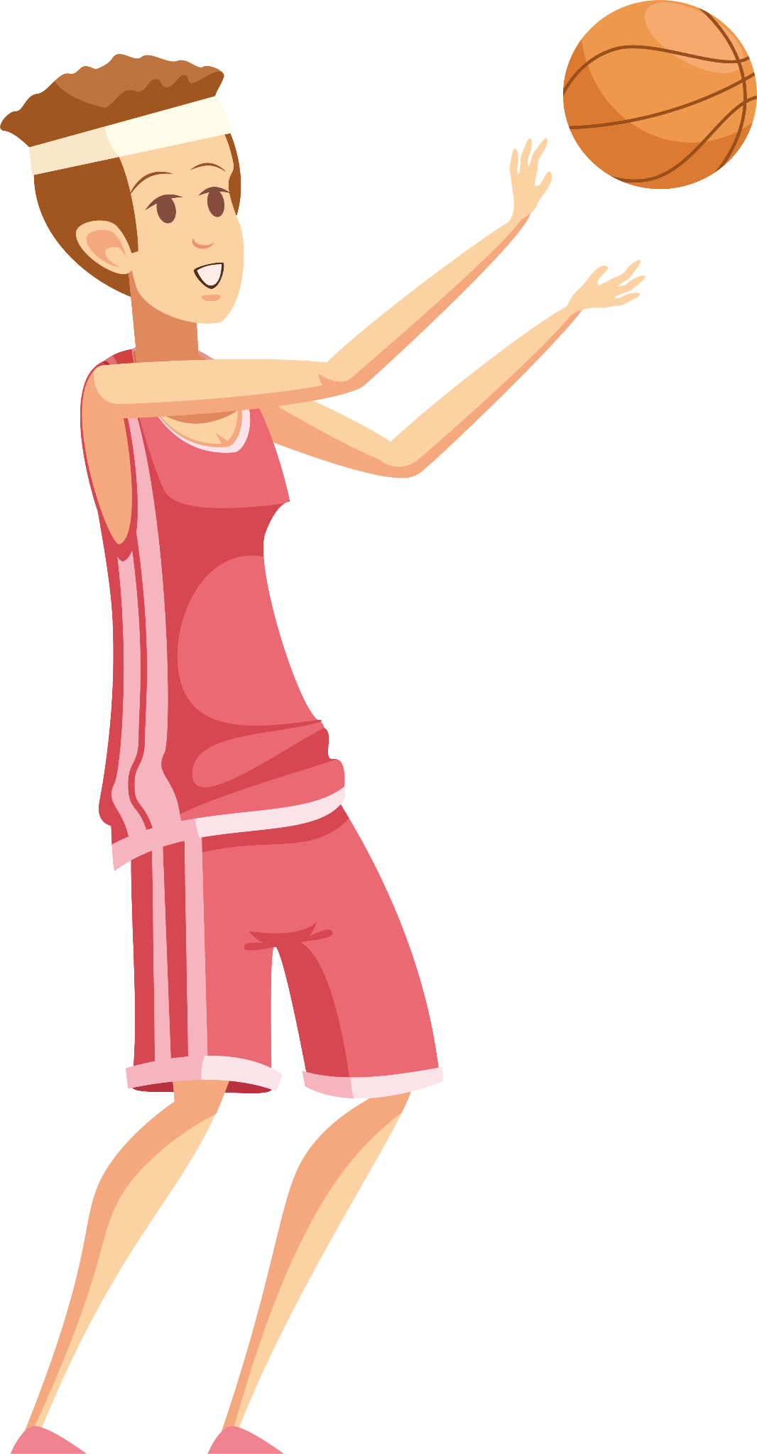
01
Nutrition
The information from this part of the presentation is adapted from Dr. Jonathan Terdiman’s (UCSF Prof. of Medicine) presentation

Slide 11
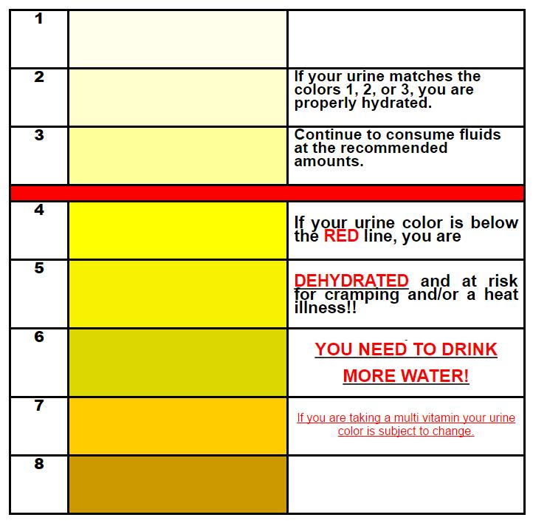
HYDRATION
You should be drinking 3-4 liters of liquid a day and your urine should be very light yellow
You’re sweating roughly 1 pound (16 oz) for every hour you workout (like run)
To replenish yourself, you need drink 16-24 oz of liquid for every hour you worked out
Drink electrolytes (gatorade, tablets) after longer workouts on on very hot, high sweat days
300 mg of sodium per hour (Gatorade has about 100 mg of sodium per 8 oz)

Slide 12
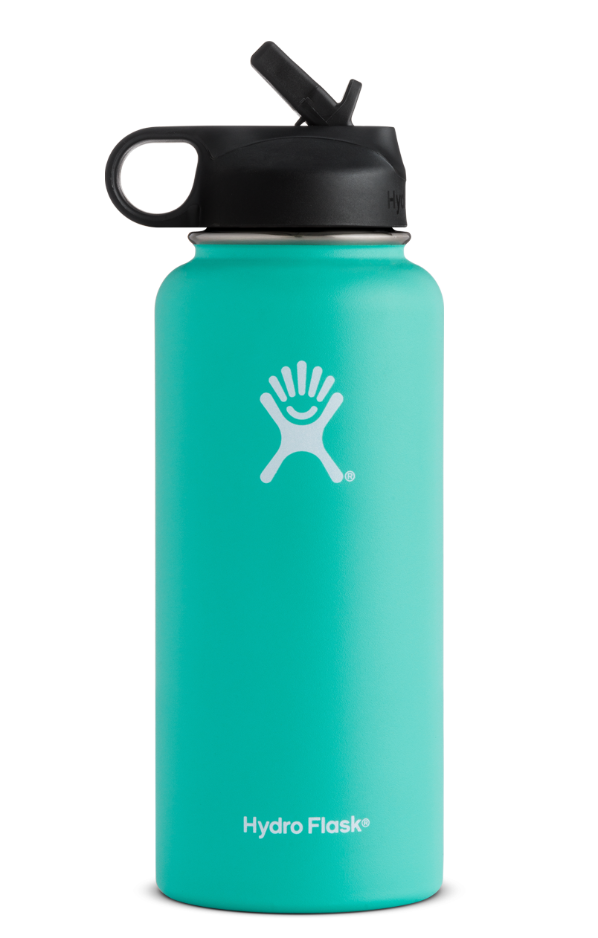
How MANY HYDROFLASKS WOULD YOU NEED TO DRINK A DAY?
(answer in chat)

Slide 13
How much?

Slide 14
hugE TIP!!
Get one of these
Find on amazon

Slide 15
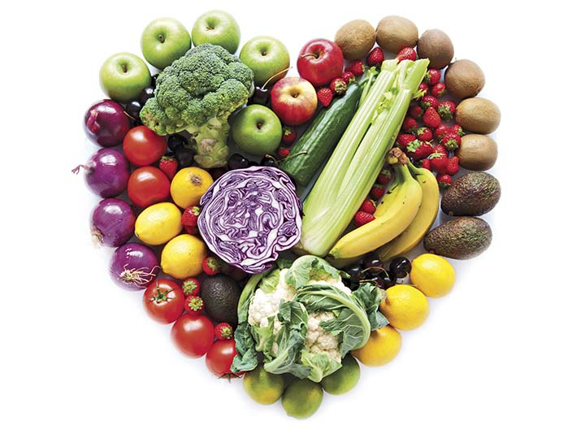
Nutrition
Bottom line: If you don’t eat after you workout, you don’t actually get any of the physical benefits.
Example: tissue damage happens when we’re running and the repair begins immediately
Refuel within 30 - 60 minutes after exercising
Consume complex carbs and protein
0.1 - 0.2 grams of protein per pound of body weight
0.3 - 0.6 grams of carbs per pound of body weight
3:1 ratio of carbs to protein
Ex. 130 - 150 pound athlete
15 grams of protein
45-50 grams of carbs

Slide 16
What TO EAT?
½ CUP OF GREEK YOGURT OR OATMEAL
2 eggs
2 oz of cashews
2 tBSP of peanut butter
21 grams of protein
21 grams of protein
10 grams of protein
8 grams of protein
bagel
Sweet potato
Slice of whole wheat bread/energy bar
48 grams of carbs
28 grams of carbs
12 grams of carbs

Slide 17
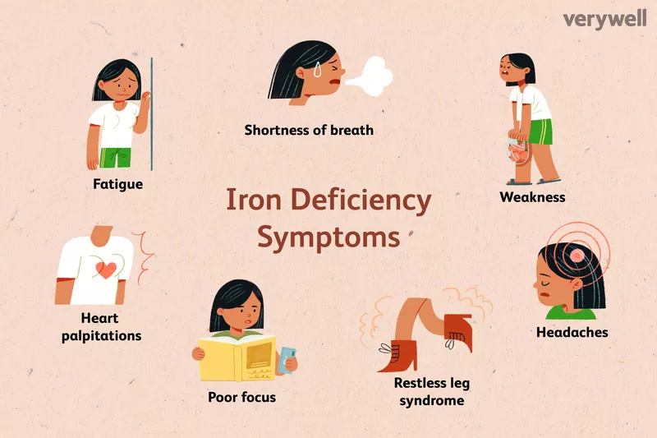
Iron deficiency
Why does it happen?
Additional information
Poor intake
Poor absorption
Bleeding
Tissue injury
Ferritin levels that are less than 50 ng/ml and iron saturation levels that are less than 15% are representative of iron deficiency
Iron deficiency can occur before anemia and can have adverse symptoms, especially for an endurance athlete
Requirements: 20 mg per day for females, add 10 mg per day for endurance athletes
Correction: iron rich foods, iron pots, Vitamin C
Iron supplementation: 65 - 135 mg of elemental iron with 500 mg of Vitamin C EVERY OTHER DAY on an empty stomach (morning is best)
How can you tell?
Dizzy every time you stand up
Tired
Everything hurts

Slide 18
SUPPLEMENTS IN SPORTS
Popular Supplements: Protein Powders, Energy Gels, Sports Drinks
consulting a healthcare professional for personalized guidance:
Individualized assessment of nutritional needs.
Ensures safety by checking for medication interactions and side effects.
Recommends reputable supplement brands for quality assurance.
Encourages a balanced, whole-foods-based diet for long-term health.

Slide 19
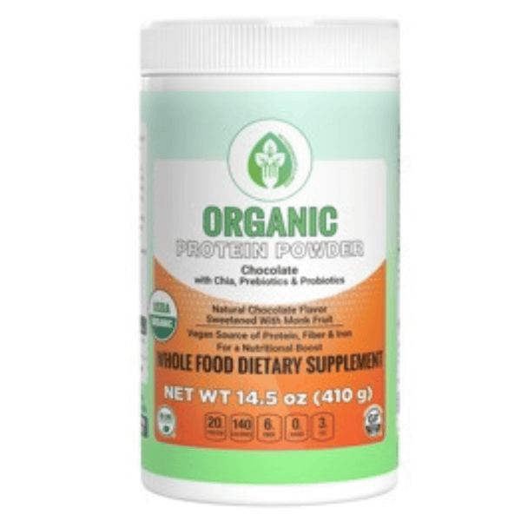
Protein Powders
Protein powders aid muscle repair and growth.
Various options (whey, casein, plant-based) available.
Consult a healthcare professional for personalized guidance to determine the right type and amount.

Slide 20
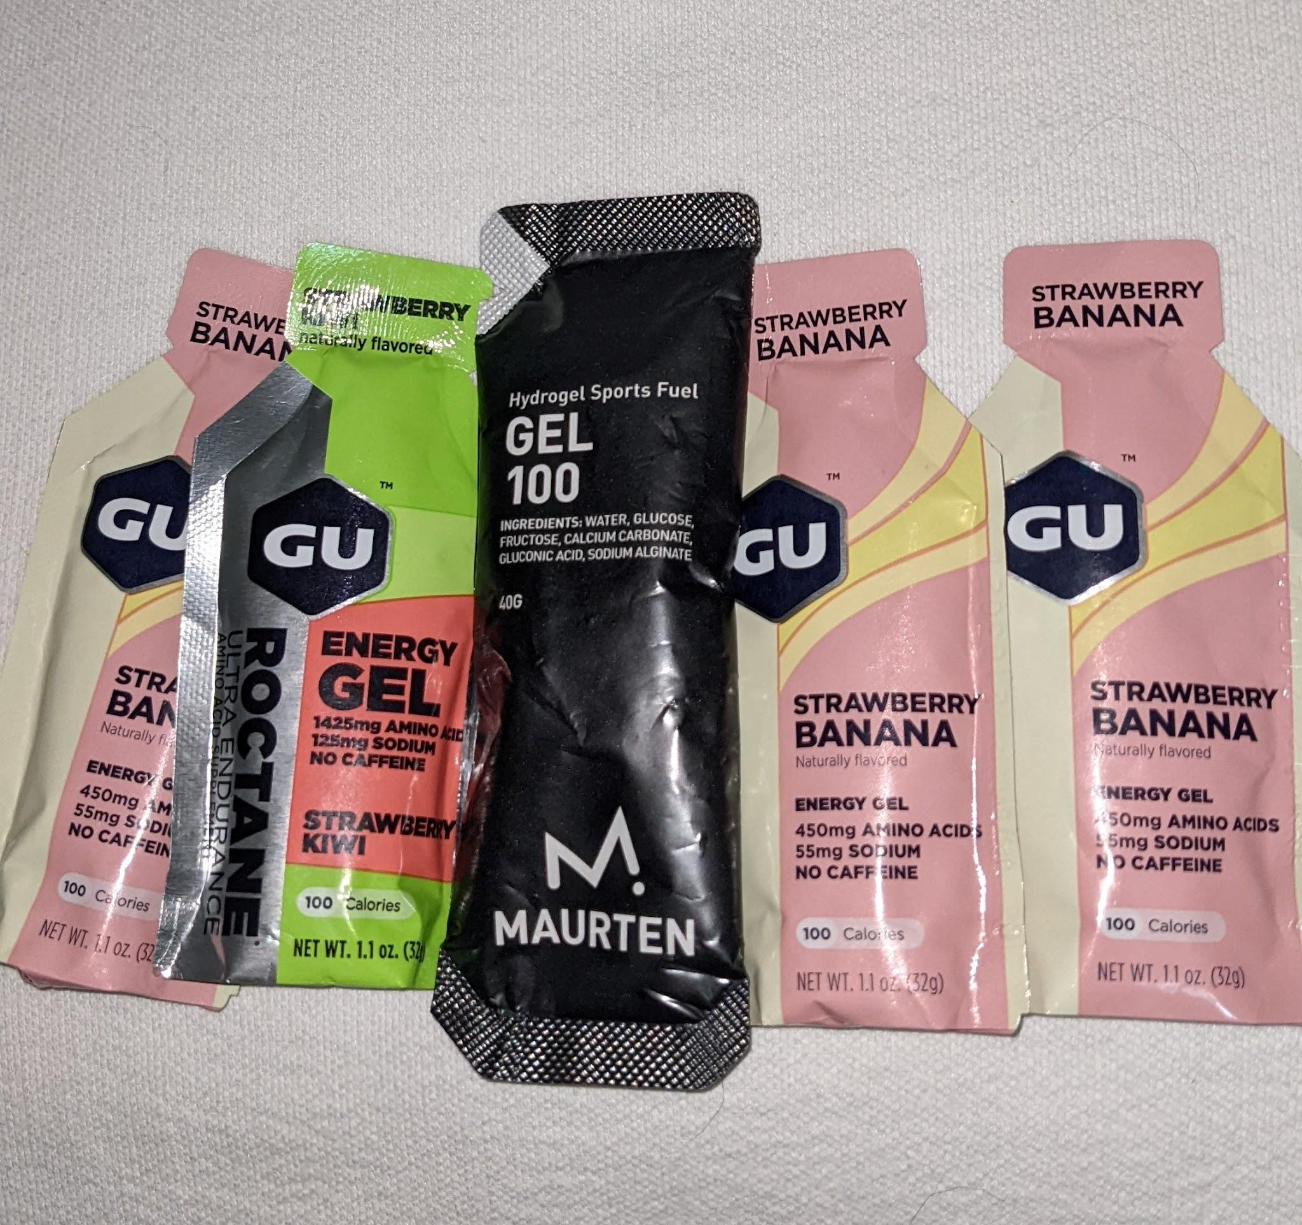
ENERGY GELS
Used by endurance athletes for quick energy during long workouts.
Prevents energy depletion during extended exercise.
Caution needed to avoid gastrointestinal issues.

Slide 21
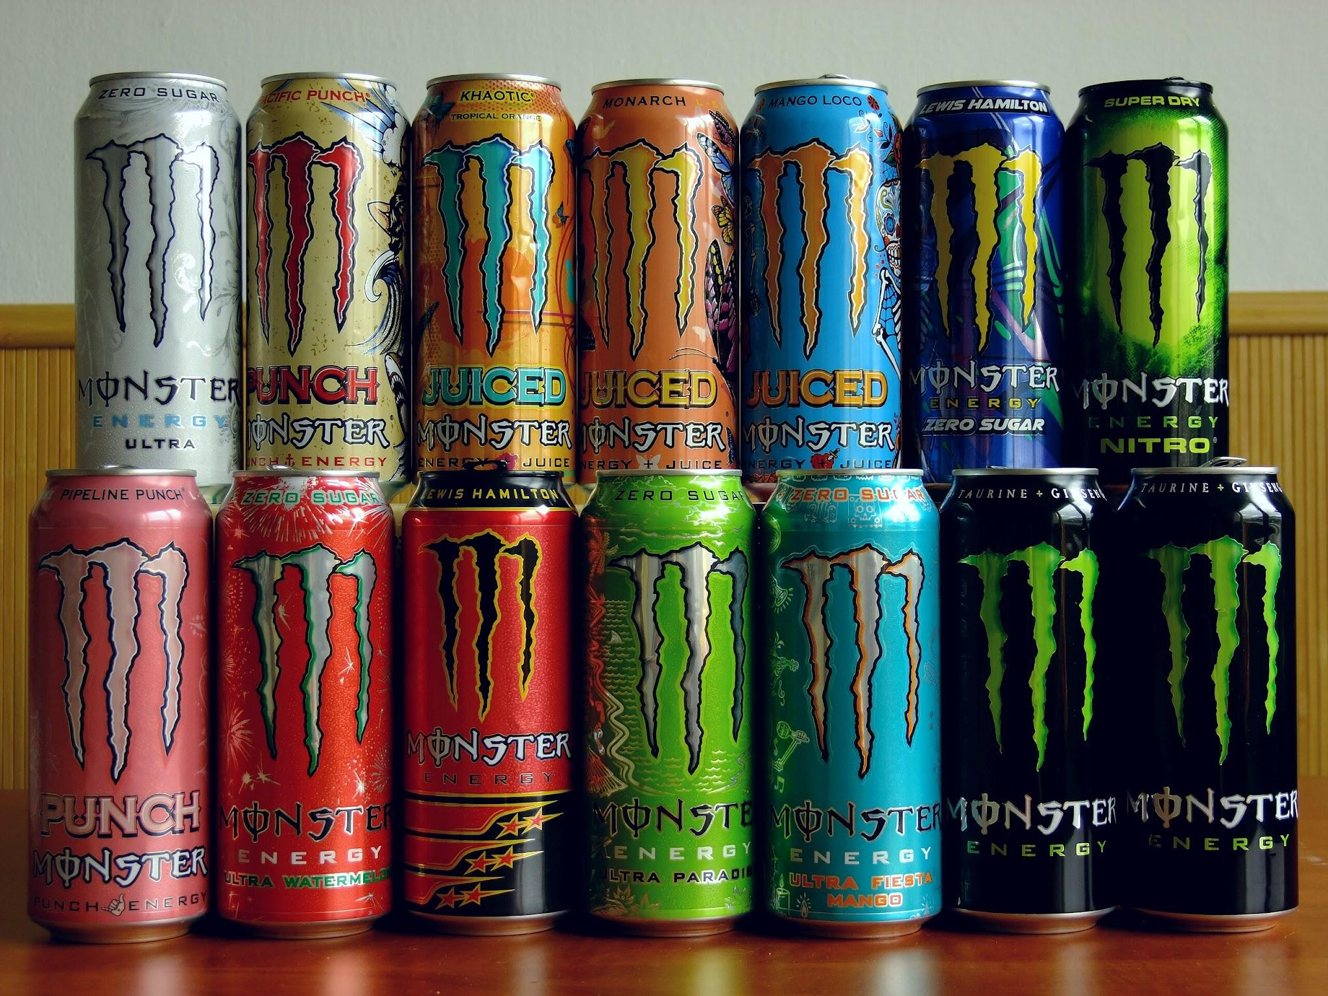
ENERGY DRINKS
Designed for hydration and electrolyte replenishment during intense activity.
Valuable for activities lasting over an hour.
Be mindful of using them during low-intensity exercise or casually due to added sugars and calories.

Slide 22
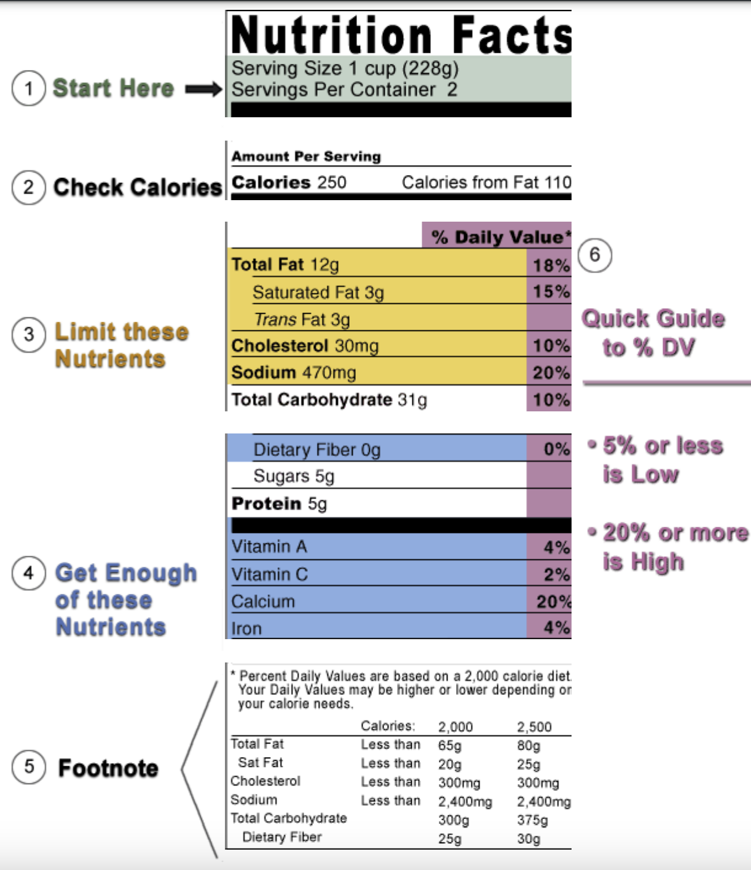
And why this diagram is misleading
How to read a label

Slide 23
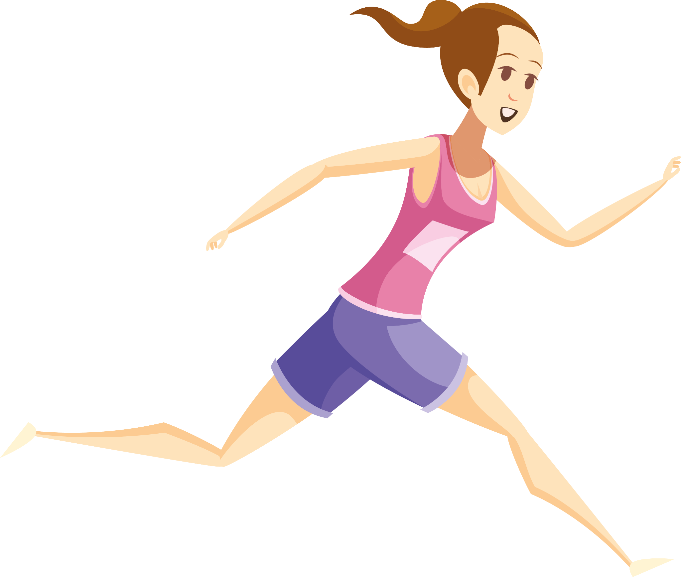
What is NORMAL?
Nearly all High School students should be gaining weight
2 - 5 pounds for a given height
3 - 5 pounds pounds per year for every inch taller
No female should have an interruption to their menstrual cycle
Exercise and good nutrition will lead to building muscle mass and some reduction in the percentage of body fat
But, for females, an increase in body fat is part of normal maturation
If you are underweight, you will get sick and tired .

Slide 24
DOES IT HELP?
Nick Symmonds - 800m champion U.S.A., ate a hunk of chocolate after every meal
Game:
In the chat, write “helpful” or “sometimes” or “never”
By “helpful” we mean that if you follow this “diet” you won’t face any health risks, in fact, in might benefit your performance
By “sometimes” we mean that this should only be done while supervised by a doctor and in certain situations
By “never” we mean NEVER.

Slide 25
Paleo Diet
Helpful!
Emphasizes foods that our hunter-gatherer ancestors would have eaten, focusing on lean meats, fish, fruits, vegetables, nuts, and seeds while excluding processed foods, grains, and dairy.
Notes:
Emphasizes foods that our hunter-gatherer ancestors would have eaten, focusing on lean meats, fish, fruits, vegetables, nuts, and seeds while excluding processed foods, grains, and dairy.

Slide 26
Carnivore Diet:
Never
Promotes an all-meat diet, excluding all plant-based foods.
Notes:
Diets that exclusively consist of animal products and exclude plant-based foods can lead to nutrient deficiencies, especially in vitamins, minerals, and fiber. They may not provide the balanced nutrition required for active teenagers.

Slide 27
Juice Cleanses or Detox Diets:
Sometimes
Involves consuming only fruit and vegetable juices for a certain period to detoxify the body.
Notes:
Sometimes
These diets often involve severe calorie restriction and provide limited nutrients. For teenage athletes, these diets can lead to weakness, poor muscle recovery, and inadequate intake of essential nutrients.

Slide 28
Extreme Low-Fat Diets
Never
Characterized by a severe restriction in the consumption of dietary fats, typically defined as containing less than 10% of total daily caloric intake from fats. This diet regimen places a strong emphasis on reducing or eliminating sources of fat, including both healthy unsaturated fats and less healthy saturated and trans fats.
Notes:
Healthy fats are essential for hormone production and overall health. Extremely low-fat diets can be detrimental for teenage girls, potentially impacting hormone balance and bone health.

Slide 29
Bottom Line
There is no “one diet” for different people
Make sure you meet the nutritional standards but it’s up to you to decide what makes the most sense
Not alone! Reach out to parent/guardians to discuss your diet
Questions?

Slide 30
Convo 2
Prompts (moderators will put in chat)
How has the media affected your perspective on what being “healthy” is? How has your perspective persisted or changed since you’ve become an athlete or grown older?
What is something your going to do to take charge of your own nutrition (can be as small as buying a bigger water bottle)?
Now again, define “healthy eating” as it would fit into your own life.
Notes:
Were going to be put into breakout rooms like last time, there will be a moderator in each room with prompts in the chat

Slide 31
Closing
Does anyone have any takeaways?
Feedback form in the chat
Notes:
I’ll be putting the feedback form in the chat, but does anyone have any takeaways that they would like to share?

Slide 32
Thank you so MUCH!
Instagram: @hittingthewallpodcast
Love to have you guys join the team
Linktree

